Slide 1

Mechatronics – 302050
Lecture Notes / PPT
UNIT III

Slide 2
Syllabus
Introduction to Signal Communication & Types-Synchronous, Asynchronous, Serial, Parallel; Bit width, Sampling theorem, Aliasing, Sample and hold circuit, Sampling frequency; Interfacing of Sensors / Actuators to Data Acquisition system; 4 bit Successive Approximation type ADC; 4 bit R-2R type DAC; Current and Voltage Amplifier.

Slide 3
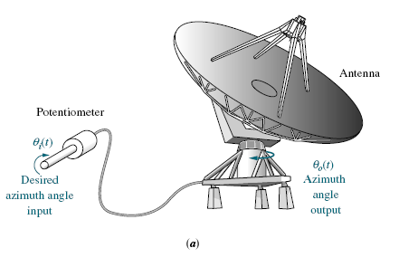
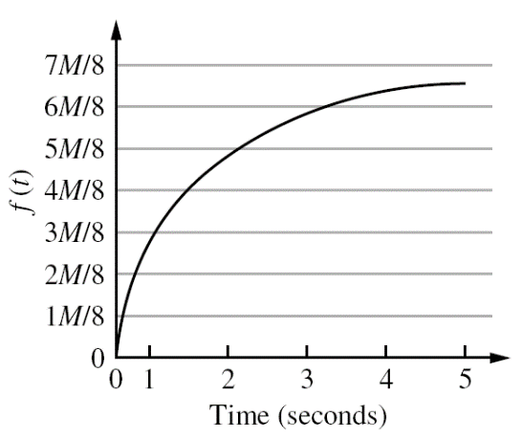
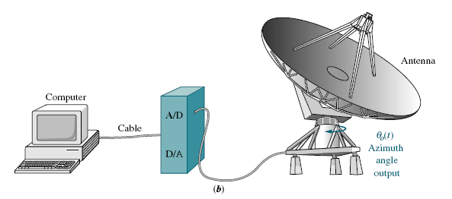
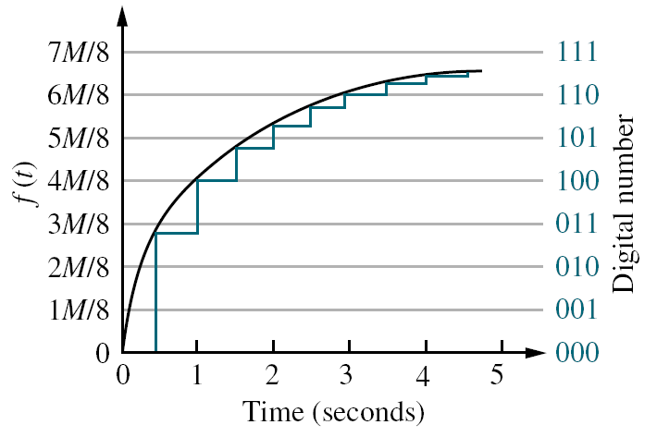
What is Analog / Digital Signal ?
Analog System
Digital Control
System

Slide 4
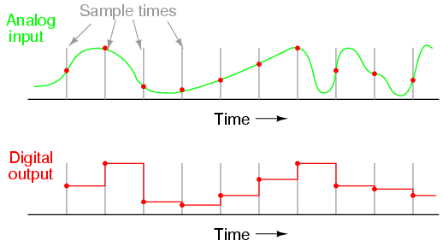
Analog - Digital Converter
Engineering signals are continuous: voltage that varies over time; a chemical reaction rate that depends on temperature, etc.
Analog-to-Digital Conversion (ADC) and Digital-to-Analog Conversion (DAC) allow digital computers to interact with these signals.
Analog-Digital Conversion Process

Slide 5
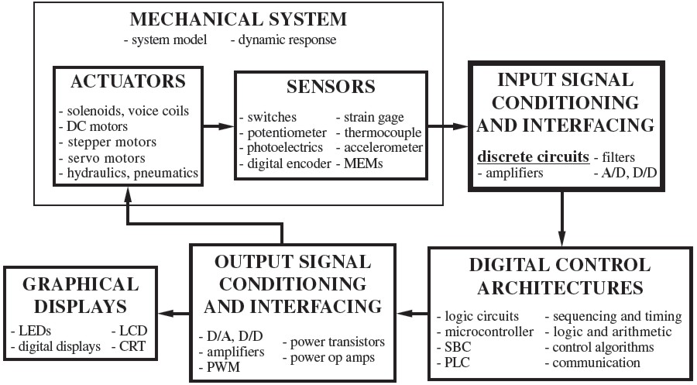
Interfacing of Sensor / Actuator to DAQ

Slide 6
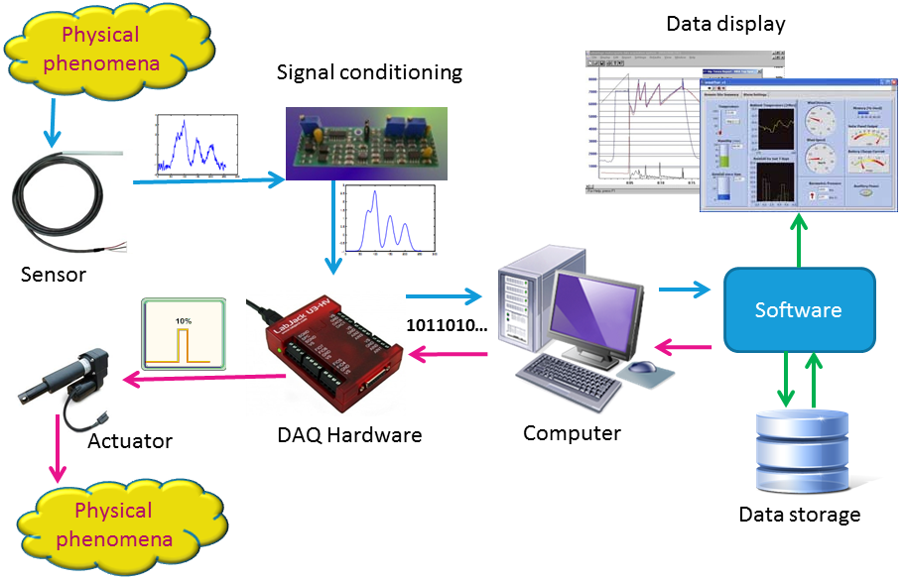
Interfacing of Sensor / Actuator to DAQ

Slide 7
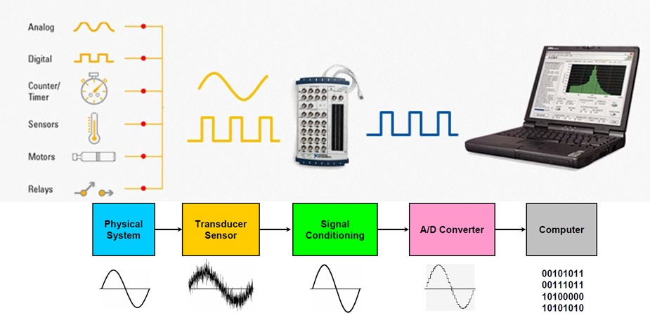
Interfacing of Sensor / Actuator to DAQ

Slide 8
Steps in DAQ
The sensor measures behavior of system
The output from the sensor is conditioned (amplified, filtered, etc.).
The conditioned analog signal is digitized using an analog-to-digital converter (ADC)
The digital information is acquired, processed and recorded by the computer.
The computer may then modify the system by outputting control signals. The digital control signals are converted to analog signals using a digital-to-analog converter (DAC).
The analog signals are conditioned (e.g. amplified and filtered) appropriately for an actuator
The actuator interacts with the system to give desired response

Slide 9
Important of DAQ
Resolution (bits) & bit width
Precision of ANALOG to DIGITAL conversion process is dependent upon the number (n) of bits the ADC of DAQ is used.
The higher the resolution, the higher the number of division the voltage range is broken into (2n), and therefore, the smaller detectable voltage changes.
Bit Width & Sampling rate

Slide 10
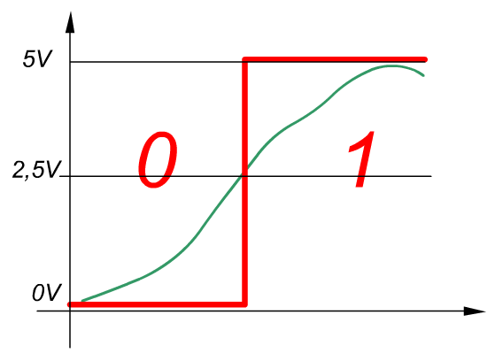
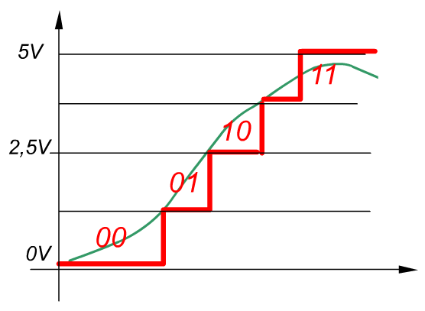
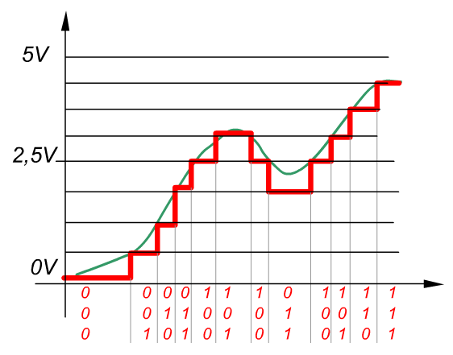
Resolution
1-bit AtoD conversion
2-bit AtoD conversion
3-bit AtoD conversion

Slide 11
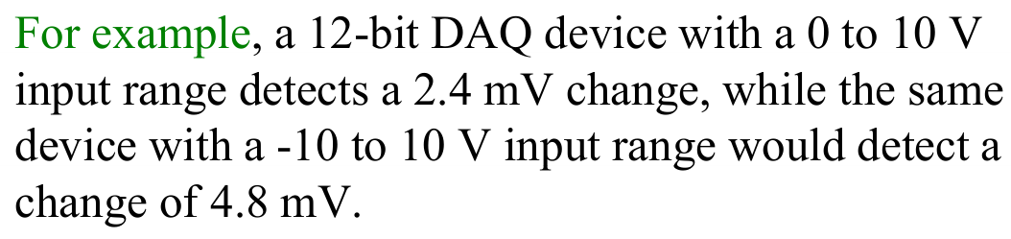
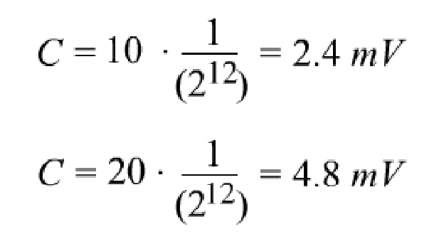
Example 1

Slide 12
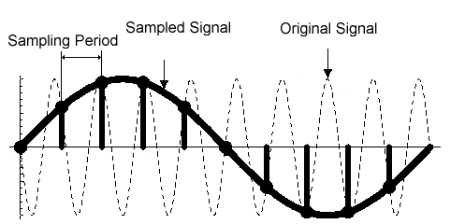
Sampling

Slide 13
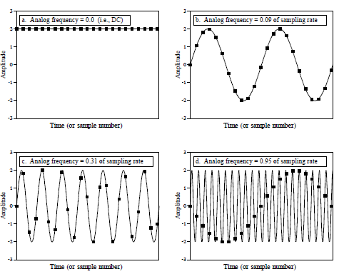
Proper and Improper Sampling

Slide 14
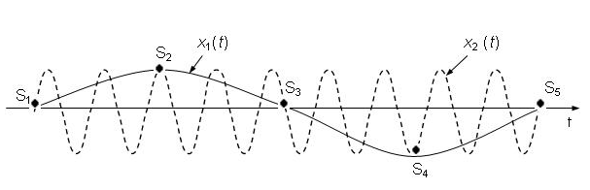
Aliasing
Aliasing results into a different signal when reconstructed from samples taken from a continuous signal
Reconstructed Signal
Actual Signal

Slide 15
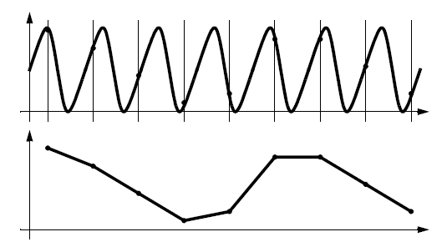
Aliasing

Slide 16
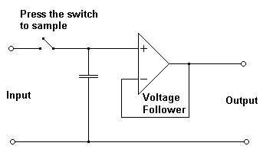
Sample and Hold Operation
SHA is used in ADC, to stabilize the voltage while it is being converted to a digital value
SHA consists of a voltage holding capacitor and a voltage follower
When the switch is closed, the output voltage is equal to the input voltage
When the switch is open, capacitor holds the voltage corresponding to the last sampled value
Sample and Hold Circuit

Slide 17
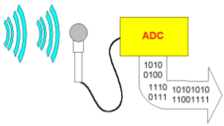
How does ADC Work?

Slide 18
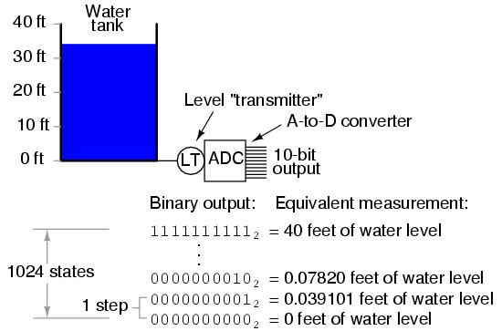
How does ADC Work?

Slide 19
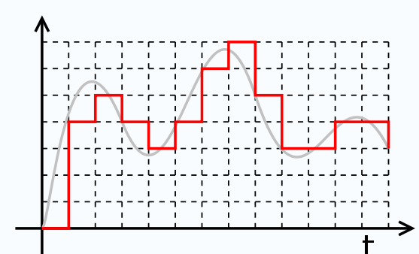
Analog to digital conversion is a two-step process:
Quantization: transformation of a continuous analog input into a set of data represented by discrete output states
Coding: assignment of a digital code word or number to each output state

Slide 20
Quantization
The analog quantization size (or resolution) Q is defined as the full scale range of the ADC divided by the number of output states:
where
(Vmax – Vmin) is range of the ADC
n is bit of ADC

Slide 21
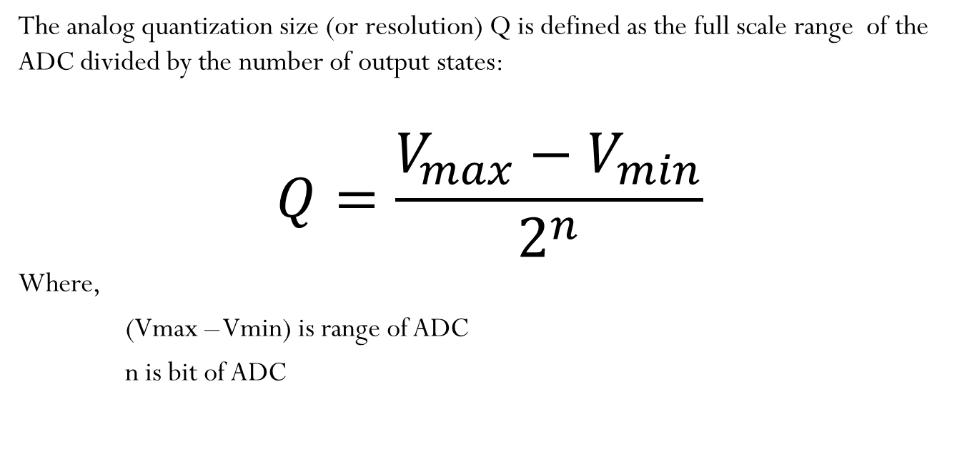
Quantization theory
The analog quantization size (or resolution) Q is defined as the full scale range of the ADC divided by the number of output states:
$$Q=\frac{V_{max}−V_{min}}{2^{n}}$$
Where,
(Vmax – Vmin) is range of ADC
n is bit of ADC

Slide 22
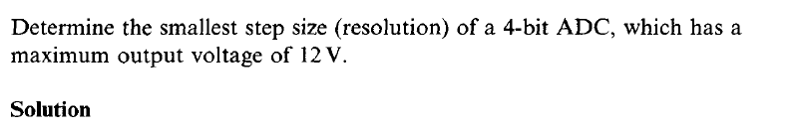
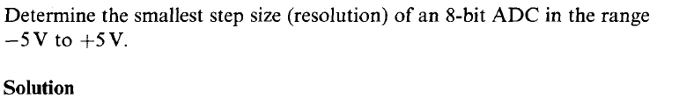
Examples

Slide 23
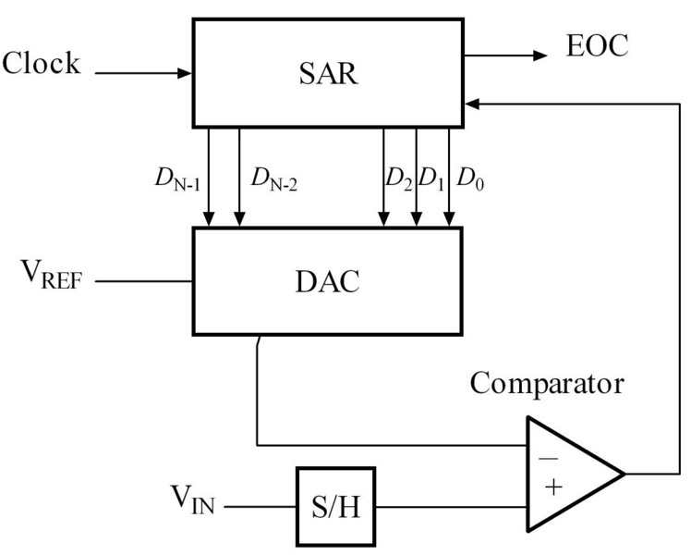
Successive Approximation Register ADC
The SAR is initialized so that the MSB is equal to a 1.
This code is fed into the DAC, which then supplies the analog equivalent of this digital code into the comparator circuit for comparison with the sampled input voltage.
If this analog voltage exceeds V_{in} the comparator causes the SAR to reset this bit; otherwise, the bit is left a 1.
Then the next bit is set to 1 and the same test is done, continuing this until every bit in the SAR has been tested.
The resulting code is the digital approximation of the sampled input voltage
SAR type ADC

Slide 24
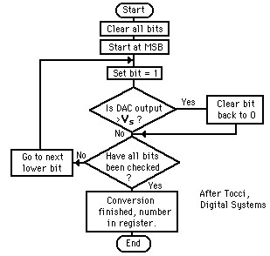
Successive Approximation Register ADC

Slide 25
Example 1
For a 10 bit ADC with a V_{ref} =1volts, find the digital equivalent of V_{in}=0.6

Slide 26
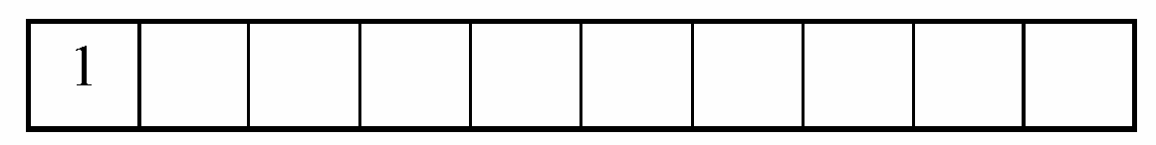
Cont….
For MSB i.e. bit 9
V= V_{ref} / 2
Compare V with V_{in}
If V_{in} is greater than V , turn MSB on i.e. =1
If V_{in} is less than V , turn MSB off i.e. = 0
V_{in} =0.6V and V =0.5
Since V_{in}> V, MSB is turned on i.e. = 1

Slide 27

Cont….
For MSB 1 i.e. bit 8
Compare V_{in}=0.6 V to V=V_{ref}/2 + V_{ref}/4= 0.5+0.25 =0.75V
Since 0.6<0.75, MSB 1 is turned off i.e = 0
For MSB 2 i.e. bit 7
Compare V_{in} with (V_{ref}/2+V_{ref}/8)=0.625
Since 0.6<0.625, MSB 2 is turned off i.e = 0
Notes:
When assessing for MSB 2, Vref/4 is not part of calculations because MSB 1=0.

Slide 28
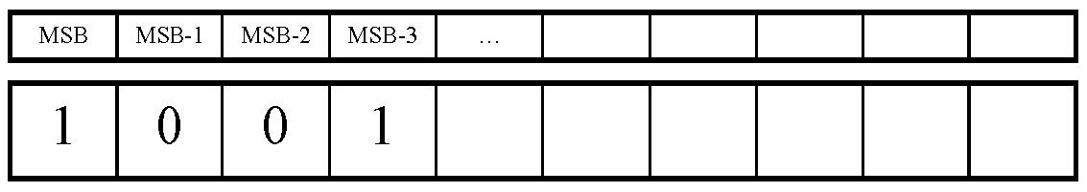
Cont….
For MSB 3 i.e. bit 6
Go to the last bit that caused it to be turned on (In this case MSB-1) and add it to V_{ref}/16, and compare it to V_{in}
Compare V_{in} to V= V_{ref}/2 + V_{ref}/16= 0.5625
Since 0.6>0.5625, MSB 3=1 (turned on)
Notes:
When assessing for MSB 3, Vref/4 and Vref/8 is not part of calculations because MSB 1=0 and MSB 2=0,

Slide 29
Cont….
This process continues for all the remaining bits
Thus, the digital equivalent of V_{in}=0.6 is: 1001100110
Notes:
If the example was repeated for 4 bit, you will see that the conversion error is more. For a converter >1o bit, the conversion error is lesser.

Slide 30
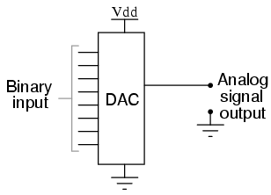
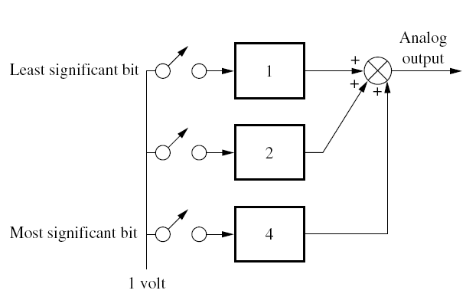
Digital -Analog Conversion
Properly weighted voltages are summed together to yield the analog output.
Three weighted voltages are summed. The three-bit binary code is represented by the switches
Thus, if the binary number is 110₂, the center and bottom switches are on, and the analog output is 6 volts. In actual use, the switches are electronic and are set by the input binary code.

Slide 31
R-2R Digital - Analog Converter
4 Bit Digital-Analog Converter using R-2R Approach

Slide 32
Digital - Analog Converter
For binary input 0001 b₀ switch is connected to the opamp and the other bit switches are grounded.
Voltage V₀ is then equal to voltage division of V₁ across to two resistors, R, in series:
On similar lines:

Slide 33
Digital - Analog Converter
For binary input 1111, voltage V₀ is then equal to:
In generic terms, for a four bit DAC, the equivalent analog output is given by:

Slide 34
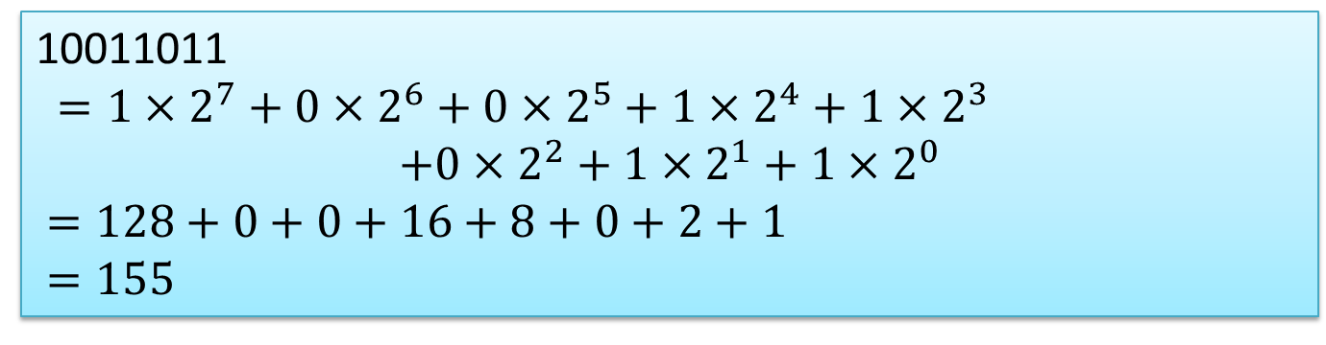
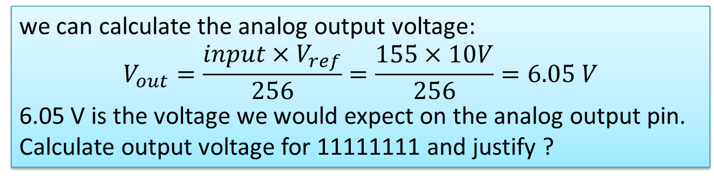
Example 1
An 8-bit R-2R DAC has a V_{ref} of 10 V. The binary input is 10011011. Find the analog output voltage.

Slide 35
Other Way of Solving Example 1
An 8-bit R-2R DAC has a V_{ref} of 10 Volts. The binary input is 10011011. Find the analog output voltage.

Slide 36
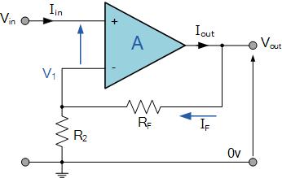
Voltage Amplifier
A non-inverting type voltage amplifier
Amplifies output voltage
Voltage input is applied to non-inverting terminal
Gain is positive and greater than unity
Consists of feedback resistor, R_{f}, to give stable, self-correcting and un-saturated output

Slide 37
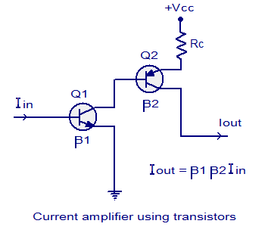
Current Amplifier
Amplifies current in a step by step process
Realized using multiple transistors
β is the gain of the transistor= collector current / base current = I_{C}/I_{B}
Output current is the product of input current and the gain, β

